Slide 1
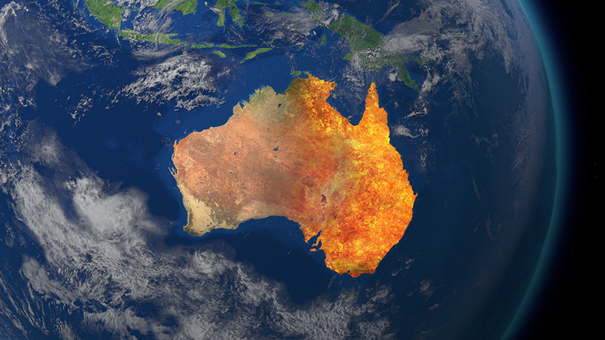
Analysis of Australian Bushfire 2019-2020
Group members:
Akash Kamboj (416014),
Sagar Garad, (415973)
Sayan Karmakar(415760)

Slide 2

Agenda
Event Description
Impact and Causes
Climate Pattern- Indian Ocean Dipole (IOD)
Dataset
Fire Spread Region
Earth skin temperature pattern
Rainfall pattern
Anomaly of temperature and rainfall
Data set and Data Preparation for ML- models
Results of ML - Models
Conclusion

Slide 3
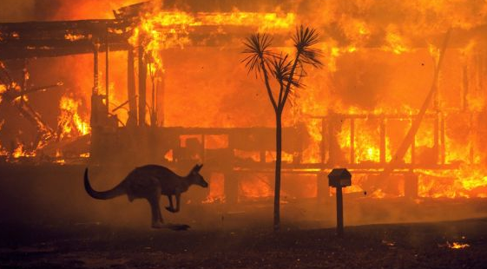
Event Description
Record breaking temperatures (49.1 deg Celsius) and months of severe drought have fueled a series of massive bushfires across central and eastern Australia
Approximately 11 million hectares of bush, forest and parks on fire across Australia
New South Wales and Victoria (>5 million hectares) is the worst hit state from 2 to 11 Jan 2020
Northwest of Western Australia, Central Australia and Eastern Australia being the other areas among the worst hit

Slide 4
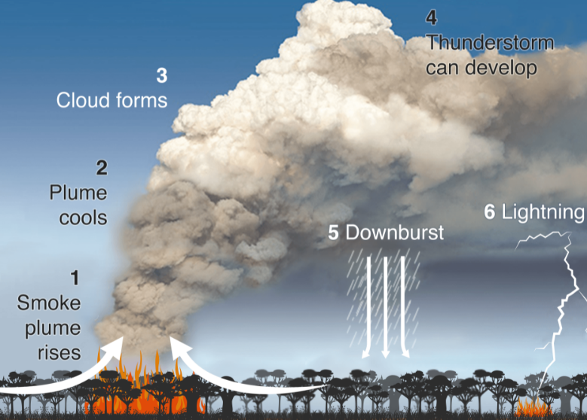
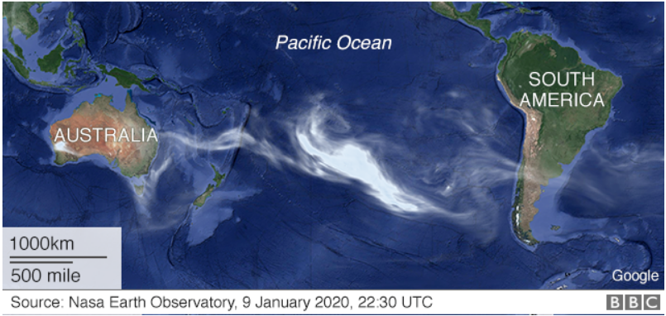
Impact and Causes
Forest Cover: 20% of Continent’s forest has been destroyed
Wildlife: 25000 koalas were killed when flames devastated Kangaroo Island on 9 Jan
Environment: Fire influenced global atmosphere composition generating smoke plumes
Canberra measured the worst air quality index in the world
Smoke from Australia bushfires drifted across the Pacific Ocean, leading to hazardous air quality for New Zealand

Slide 5
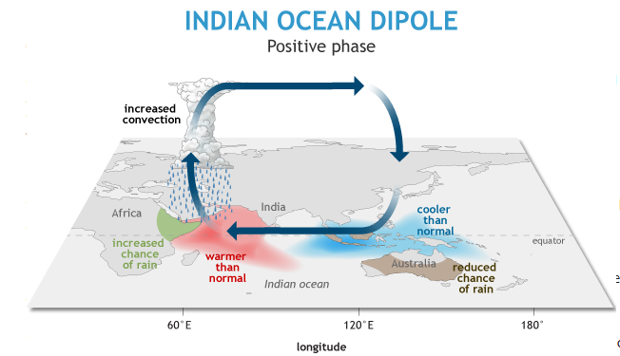
Climate Pattern- Indian Ocean Dipole (IOD)
The heat has been a positive Indian Ocean Dipole (IOD) - an event where sea surface temperatures are warmer in the western half of the ocean, cooler in the east.
During the positive phase of the IOD (like what happened in the Southern Hemisphere winter and spring of 2019), cooler-than-normal sea surface conditions in the eastern Indian Ocean near Java and Sumatra accompany warmer-than-normal conditions in the western tropical Indian Ocean.
This east-west contrast in ocean conditions (a “dipole”) alters the wind, temperature, and rainfall patterns in the region, typically bringing floods to eastern Africa and droughts and bushfires to eastern Asia and Australia, among other ecological and socio-economic impacts. During the negative IOD phase, the locations of the warm/cool pattern and associated impacts reverse.
The difference between the two temperatures is currently the strongest in 60 years. Elevated risk in Australia continues

Slide 6
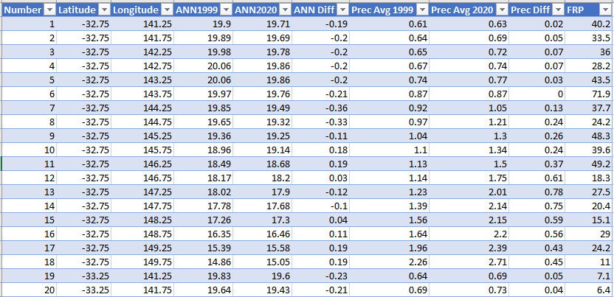
Dataset
Geographical data taken from NASA website
Annual average of earth skin temperature and precipitation are considered to plot the graphs
Calculated difference of annual temperature between 1999 and 2020
Fire radiation pattern considered to check the intensity of fires

Slide 7
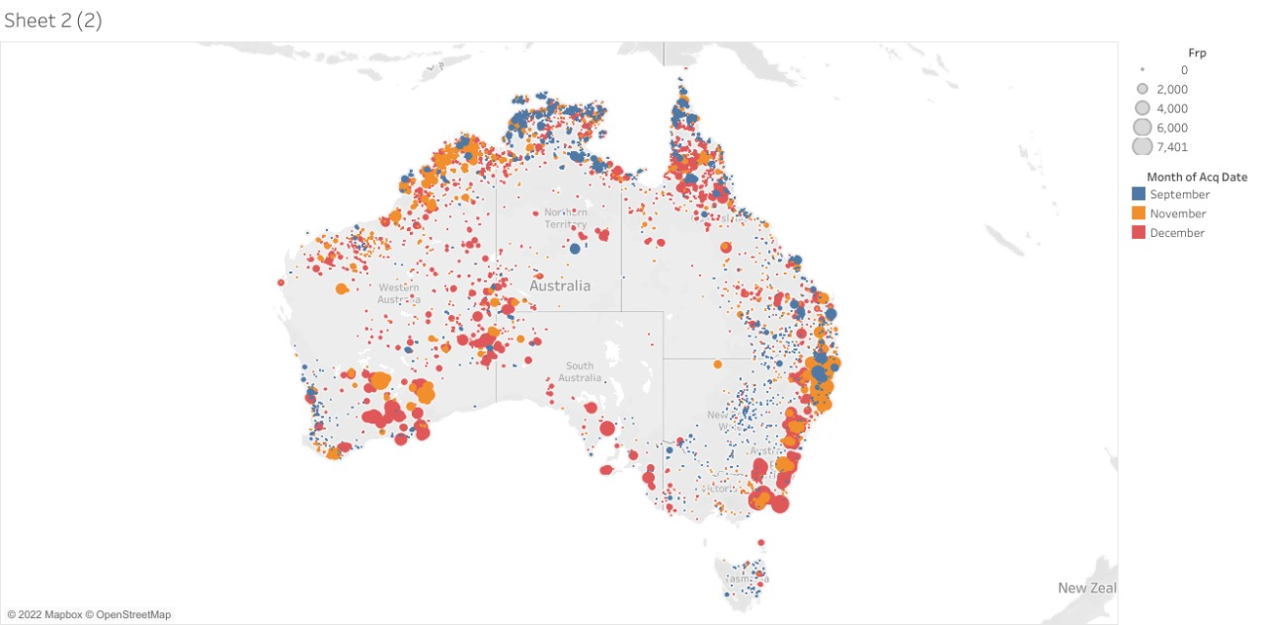
Fire Spread Region
Fire initially broke out in the Northern of Australia
Eventually spread along the coastal region and some part of the central region
Maximum fire intensity was observed in the south east region

Slide 8
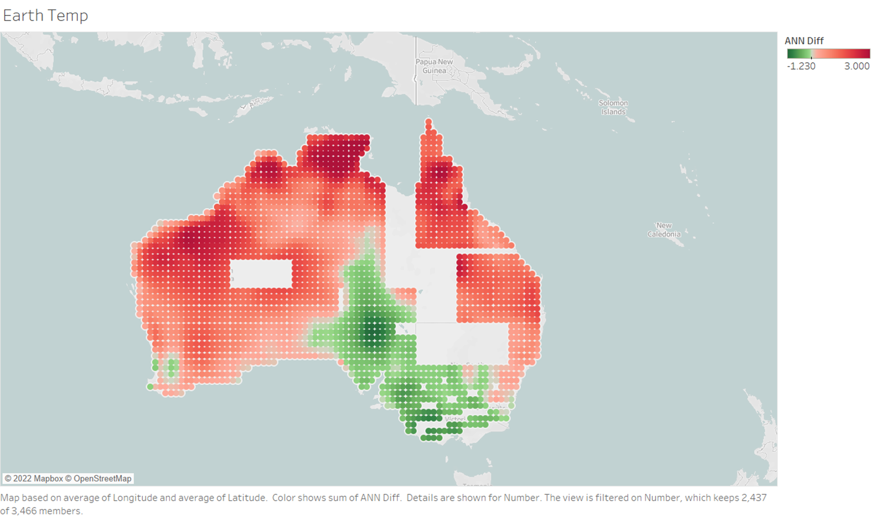
Earth skin temperature pattern
Data taken from NASA website from 1981 to 2020.
Plotted difference of earth skin temperature from 1999 to 2020
The difference scale shows that in most of the region land temperature has been increased by 0 to 3 degrees

Slide 9
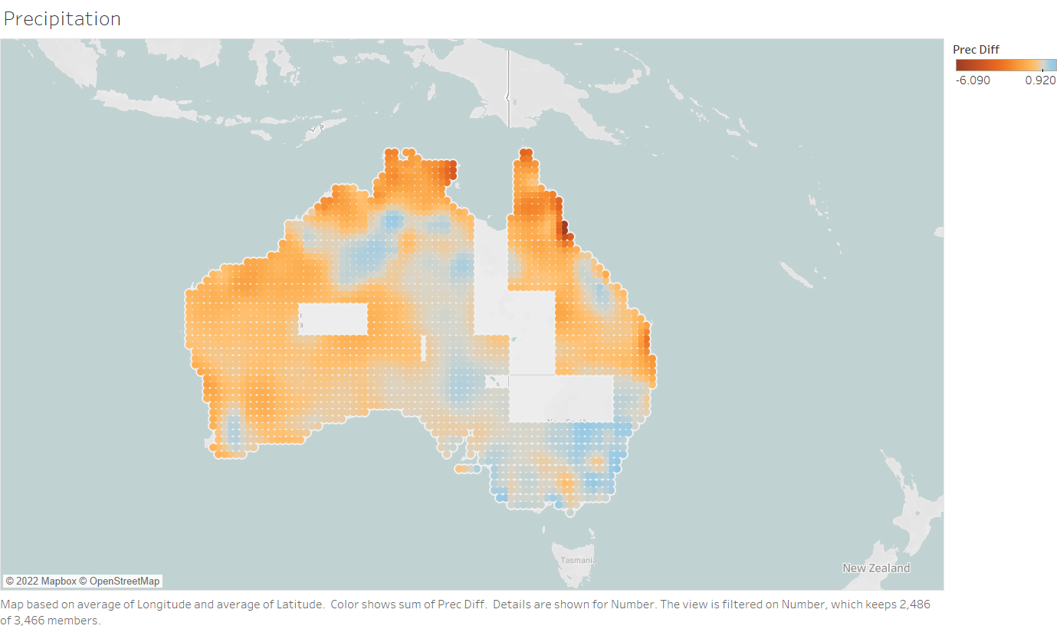
Rainfall pattern
Data taken from NASA website from 1981 to 2020.
Plotted difference of average precipitation from 1999 to 2020
The difference scale shows that in most of the parts rainfall has been declined by 0 to 6 mm

Slide 10
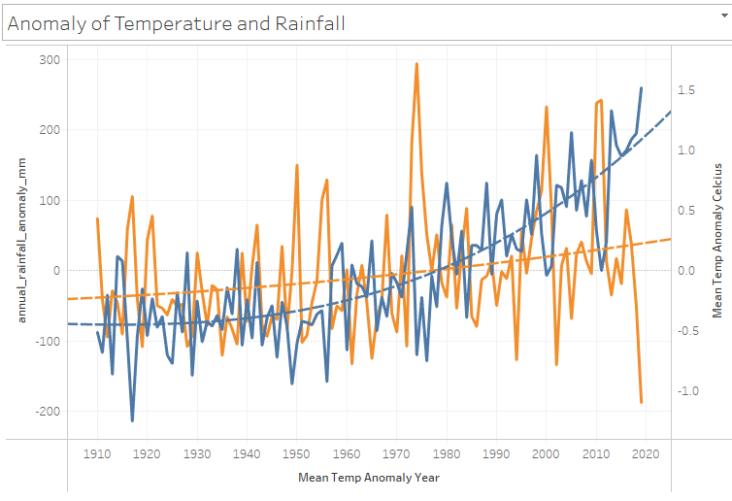

Anomaly of temperature and rainfall
Mean temperature anomaly tends to be rising since 1990 reaching peak in 2019 (1.5 deg Celsius)
Decrease in rainfall anomaly highest in 2019

Slide 11
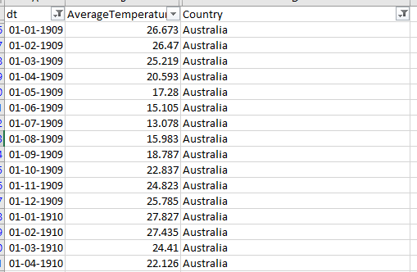
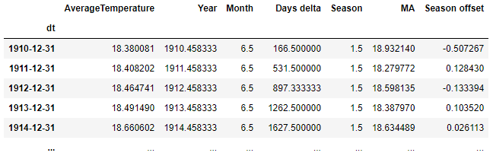
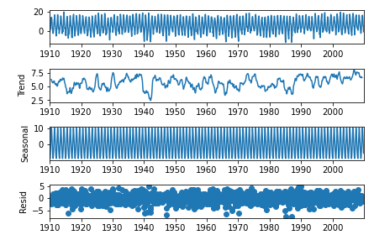
Data set and Data Preparation for ML- models
Dataset: Average land temperature taken from 1909 to 2012
Filtering the data for country and dates
Handling Null Values
Removal of unwanted parameters
Conversion to Date-Time index
Resampling the data annually
Seasonal Decomposition to analyze trend, seasonal cycle and residuals of the data

Slide 12
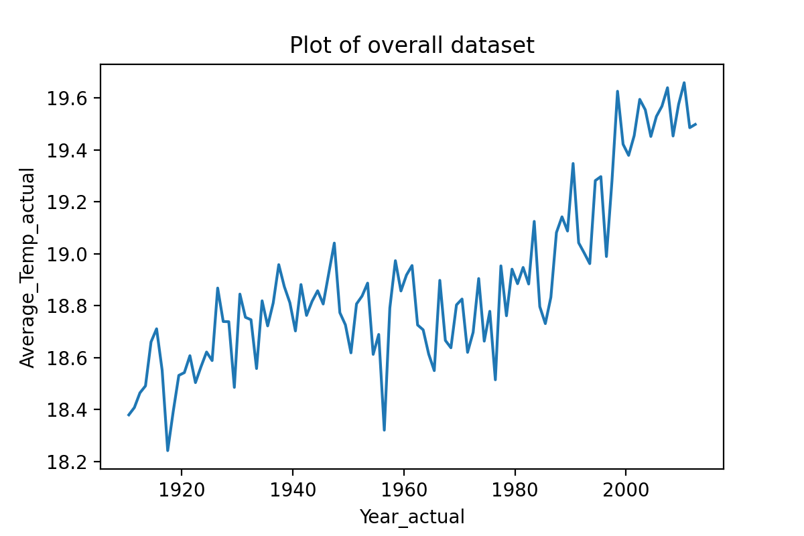
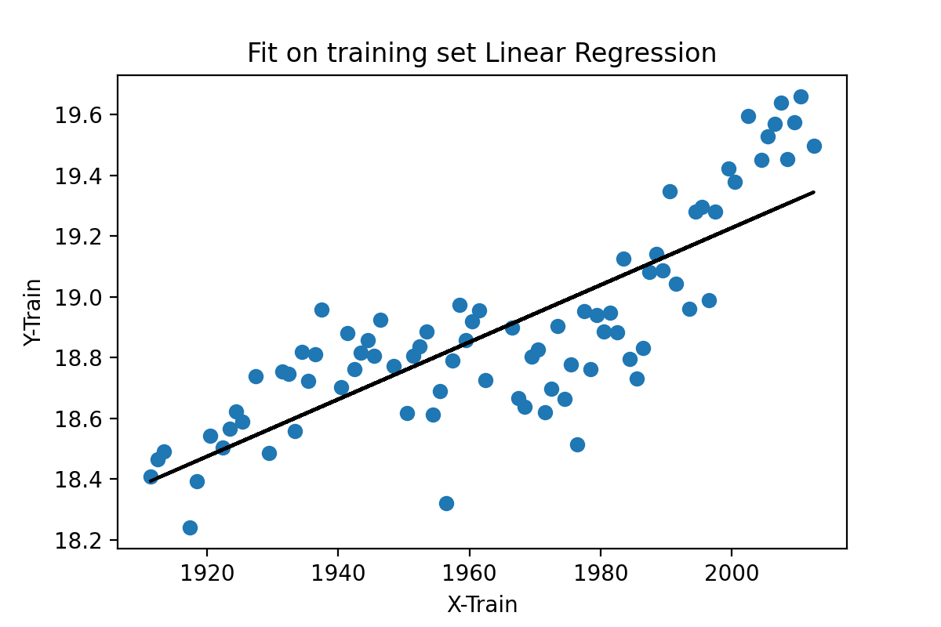
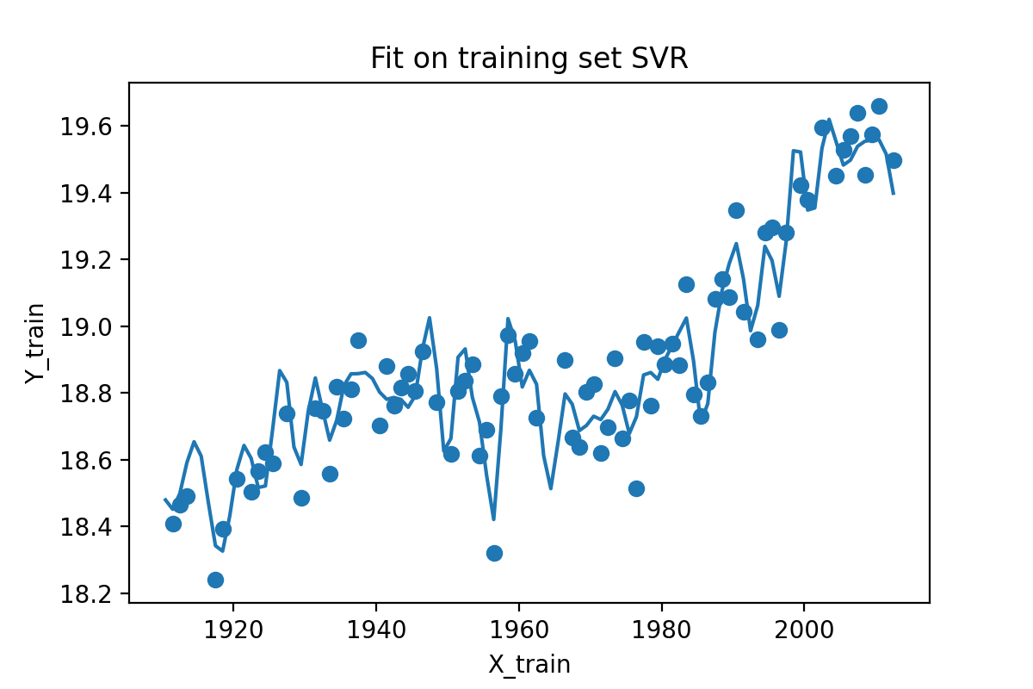
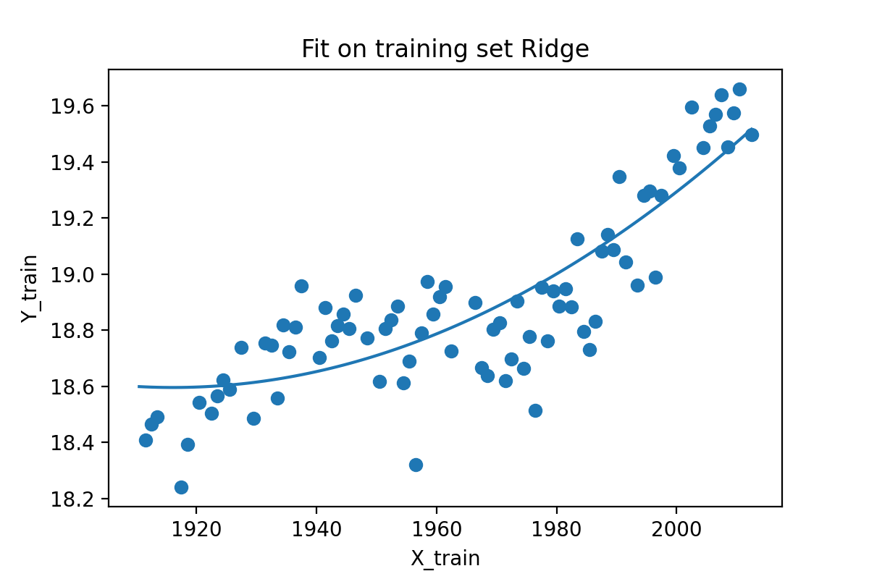
Results of ML - Models
Machine Learning Models: Linear Regression, Support Vector Regression and Ridge Regression
SVR: Low bias, High Variance
Ridge: Low bias, Low Variance

Slide 13
Results of ML - Models
Ridge has better accuracy and coefficient of determination as compared to linear regression which represent better predictability of the model.
SVR has highest coefficient of determination but lower MSE. Hence, it is overfitting.
Actual Avg temp in 1990 was 19.1 deg C.
Ridge Regression has a temperature difference of 0.5 deg Celsius when compared with 1990 and 2019
ML Model | Accuracy of the model | MSE | RMSE | Coefficient of determination | Prediction 2019 | Prediction 2030 | Prediction 2050
Linear Regression | 0.64 | 0.03 | 0.19 | 0.74 | 19.34 | 19.43 | 19.60
Support Vector Regression | 0.93 | 0.006 | 0.08 | 0.95 | 18.88 | 18.88 | 18.88
Ridge Regression | 0.73 | 0.02 | 0.14 | 0.84 | 19.64 | 19.88 | 20.37

Slide 14
Conclusions
Australia’s climate has warmed by over 1 °C since 1960. Australia experienced its hottest year on record in 2019, with average temperatures 1.52 deg Celcius above the 1961-1990 average.
Visualisations depict that the main regions fire spread in Australia is closely related to regions land temperature and rainfall pattern.
Among the different machine learning models, prediction using Ridge regression has more reliable results.
Using Ridge, the temperature difference between 1990 and 2019 is around 0.5 deg Celsius, while the difference increases to 0.78 and 1.27 deg Celsius for years 2030 and 2050 respectively.

Slide 15
References:
http://www.bom.gov.au/state-of-the-climate/australias-changing-climate.shtml
https://power.larc.nasa.gov/data-access-viewer/
https://treehozz.com/what-does-temperature-anomaly-mean
https://www.bbc.com/news/world-australia-50951043
https://github.com/esharma3/project_australian_bushfires_webapp/tree/master/data/climate_data
https://www.kaggle.com/nagarajbhat/australian-bushfire-map-analysis/notebook
https://www.kaggle.com/trentbrooks/australian-land-temperatures-forecast/data?select=AustraliaLandTemperatures-forecast-monthly-prophet-plot-components.png

